Slide 1
Build x : android
Lecture Four: Preferences and Databases
Handout:
https://tinyurl.com/android-lecture4-handout

Slide 2
Recap
Handout:
https://tinyurl.com/android-lecture4-handout

Slide 3
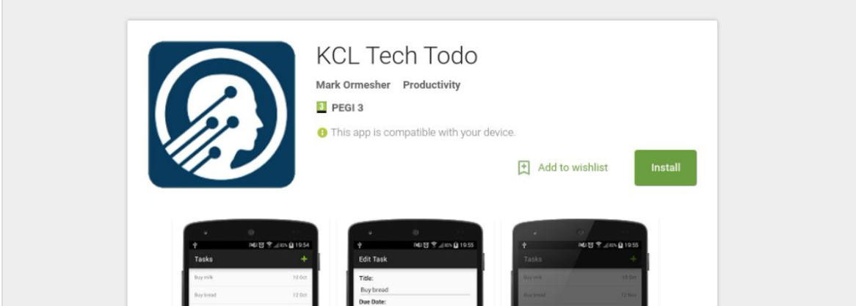
Recap – What are we doing?
We’re going to build a basic todo list app, KCL Tech Todo.
If you want a preview, it is available on Google Play.
Search for ”KCL Tech Todo” on Google or on the Play Store.

Slide 4
Recap - ListViews
ListViews ...
Adapters …

Slide 5
Recap - ListViews
ListViews display a list of items in any kind of list format.
They recycle views in the list to save memory, only showing what is needed.
Adapters map data to a ListView, maintaining a separation of concerns.
These have getCount(), getItem() and getView().
This means that any type of data that can fit into an adapter can be displayed in a ListView.

Slide 6
Storing Data
Handout:
https://tinyurl.com/android-lecture4-handout

Slide 7
Storing Data
There are many reasons why you’d want to store data on a user’s device.
Preferences, app content, high scores, game progress, usage logs, etc.
The data is persistent, meaning it still exists if the app closes or the device reboots.
There are three main ways to store data…

Slide 8
Storing Data: Plain Files
Your app can write and read any kind of file to a private area, accessible only to your app.
This is useful if you have your own proprietary file format, or your have large BLOBs (Binary Large OBject) of data to store.
We will not be using or studying this method.

Slide 9
Storing Data: Shared Preferences
Shared preferences is a utility built into Android that is primitive, but very easy to use.
You can use shared preferences to store simple key/value information.

Slide 10
Storing Data: Databases
Your app can create and use as many databases as it wants.
Databases are great for storing structured data that needs to be organised, searchable, etc.
Databases are the most complicated method, but also the most powerful.

Slide 11
Shared Preferences
Handout:
https://tinyurl.com/android-lecture4-handout

Slide 12
Storing Data: Shared Preferences
Shared preferences are designed to store a user’s preferences and settings, like whether they have notifications turned on.
However… you can actually use the for any kind of simple key/value information.

Slide 13
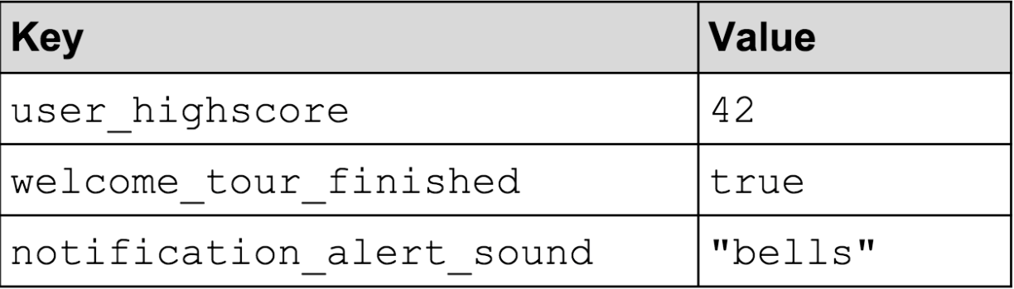
Storing Data: Shared Preferences

Slide 14

Coding time!
Handout:
https://tinyurl.com/android-lecture4-handout

Slide 15
Side Note: Models

Slide 16


Not this kind of model.

Slide 17
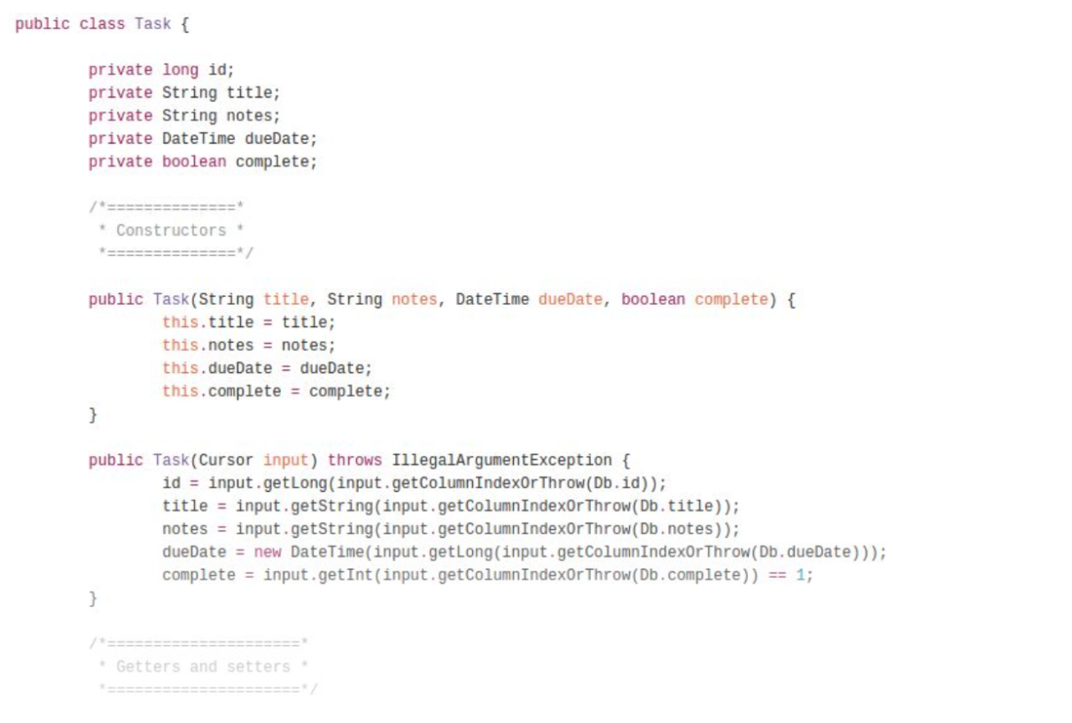
This kind of model!

Slide 18
Models
A model is a representation of some item or entity.
In Java (and therefore Android), a model is generally a class that represents one of the items or entities your software deals with.
We need a model that represents a task.

Slide 19

Coding time!

Slide 20
Databases
Handout:
https://tinyurl.com/android-lecture4-handout

Slide 21
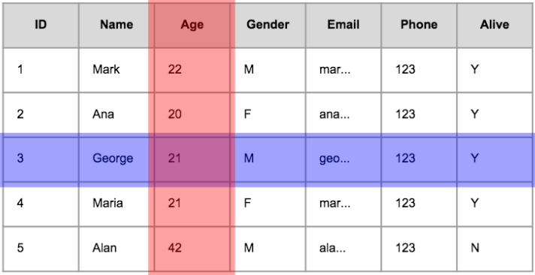
Databases: 60-Second Recap
A database contains many tables
A table looks like this
Column
Row:
A single object, item, record
or entity of your data.
Column:
A property or attribute about
your data.
Row

Slide 22
Databases: SQL and SQLite
Databases often use SQL, which stands for Structured Query Language.
A set of questions and commands you can send to a database.
Allow you to create, read, update and delete records.
Android uses SQLite, which is a lightweight version of SQL.
It’s a bit less powerful, but also better at running on mobile devices.
Example queries:
SELECT Name, Age FROM Users;
SELECT * FROM Users WHERE alive = “Y”
SELECT * FROM Users ORDER BY age DESC;

Slide 23
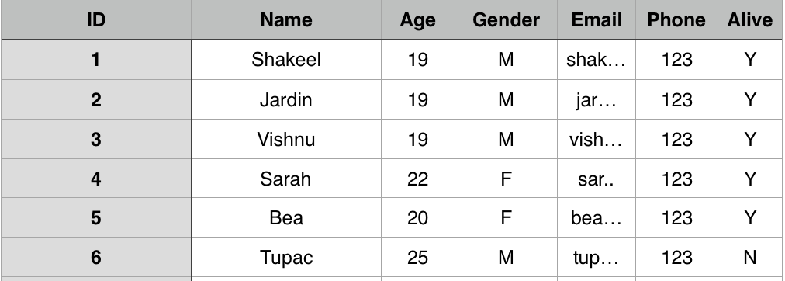
Databases: SQL
Users
SELECT Name, Age FROM Users;

Slide 24
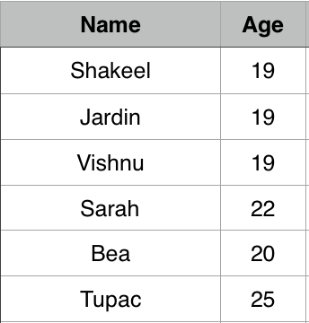
Databases: SQL
SELECT Name, Age FROM Users;
SELECT Name, Age FROM Users;

Slide 25
Databases: SQL
Users
SELECT * FROM Users WHERE alive = “Y”

Slide 26
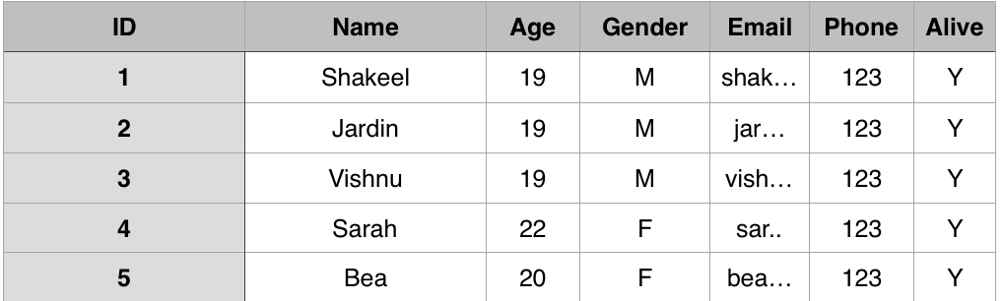
Databases: SQL
SELECT * FROM Users WHERE alive = “Y”
SELECT * FROM Users WHERE alive = “Y”

Slide 27
Databases: SQL
Users
SELECT * FROM Users ORDER BY age DESC;

Slide 28
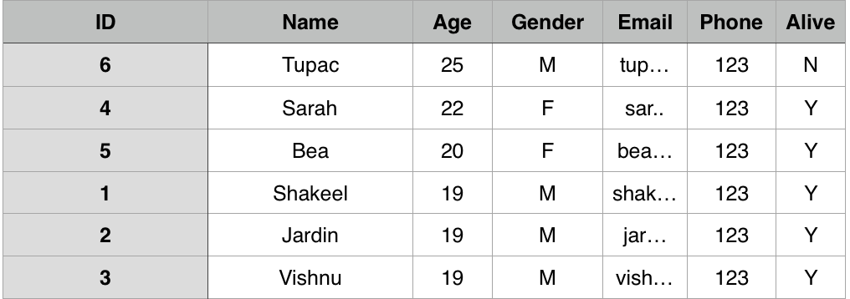
Databases: SQL
SELECT * FROM Users ORDER BY age DESC;
SELECT * FROM Users ORDER BY age DESC;

Slide 29
Databases
We will cover four parts to using databases in Android;
Creating a database handler/helper
Creating a table
Inserting a task
Reading tasks

Slide 30

Break! 10 mins
Handout:
https://tinyurl.com/android-lecture4-handout

Slide 31
Databases: Creating a Helper
Handout:
https://tinyurl.com/android-lecture4-handout

Slide 32
Databases: Creating a Helper
A helper/handler is a tool that makes working with SQLite databases easier.
Remember how we made an adapter by extending BaseAdapter?
To make our own helper, we extend SQLiteOpenHelper.

Slide 33

Coding time!

Slide 34
Databases: Creating a Table

Slide 35
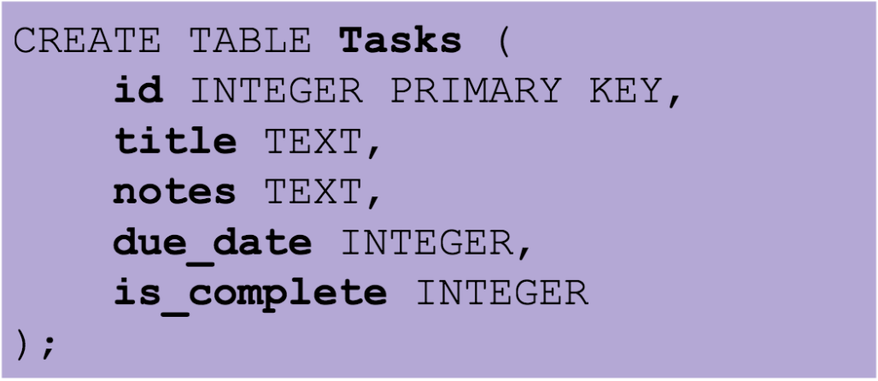
Databases – Creating a Table
We will use an SQL command to create a table.

Slide 36

Coding time!

Slide 37
Databases: Inserting a Task

Slide 38
Databases: Inserting a Task
We could use SQL, but there’s a better way.
If we can convert our task into a ContentValues object, we can insert that directly.
A ContentValues object simply stores key/value pairs of information, just like a Bundle (lecture three).
We’re going to handle create and update of a Task in the same method by telling the database to replace any task that has the same ID.

Slide 39

Coding time!

Slide 40
Databases: Reading Tasks

Slide 41
Database: Reading Tasks
This time we will use SQL – using two different queries.
To get all uncomplete tasks:
SELECT * FROM Tasks WHERE is_complete = 0 ORDER BY due_date ASC;
To get a single, specific task:
SELECT * FROM Tasks WHERE id = 0;

Slide 42
Databases: Reading Tasks/Cursors
Both of those queries return a Cursor. Cursors are special…
A cursor is one object that can represent any number of rows from your database.
It does this by only “looking at” one record at a time and using a pointer to remember which one it is currently looking at.

Slide 43
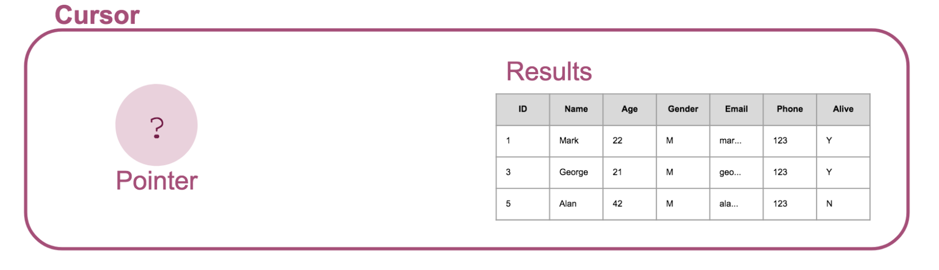
Databases: Reading Tasks/Cursors
Here is an example result set, and our pointer. To start with, it doesn’t point to anything.

Slide 44
Databases: Reading Tasks/Cursors
We can call moveToFirst() to start looking at the first result.
This returns false if there isn’t a first result (i.e. the result set is empty).
0

Slide 45
Databases: Reading Tasks/Cursors
We can now use getInt(…), getString(…) to read information about the active result.
0

Slide 46
Databases: Reading Tasks/Cursors
These methods take the column number as an argument, starting at zero.
getInt(0) -> 1
getString(1) -> “Mark”
getInt(2) -> 22
0

Slide 47
Databases: Reading Tasks/Cursors
To move onwards, we can call moveToNext().
1

Slide 48
Databases: Reading Tasks/Cursors
If we call moveToNext() again…
1

Slide 49
Databases: Reading Tasks/Cursors
If we call moveToNext() again…
2

Slide 50
Databases: Reading Tasks/Cursors
If we call moveToNext() once more we run out of records, so it returns false to tell us there wasn’t a ”next” record.
2

Slide 51
Databases: Reading Tasks/Cursors
If we call moveToNext() once more we run out of records, so it returns false to tell us there wasn’t a ”next” record.
?

Slide 52

Coding time!

Slide 53
Next Week: Putting it Together!
We will put everything we’ve learned so far together into a complete working app!
Make sure you are up to date with everything we’ve done so far.
I’ll upload all resources, slides and “work so far” code later this week for you all to look at.

Slide 54

Done!

